Slide 1
Hiring Process Analytics
By Sonali Gupta

Slide 2
Project Description
Analyze the company's hiring process data and draw meaningful insights from it.
The hiring process is a crucial function of any company, and understanding trends such as the number of rejections, interviews, job types, and vacancies can provide valuable insights for the hiring department.
The insights provided by a data analyst could potentially help the company improve its hiring process and make better hiring decisions in the future.

Slide 3

Tech-Stack Used
To complete this project, I am using MS Excel 2021 as the given dataset is small in size and MS Excel is an excellent analysis tool to analyze small size datasets.
It can also be used for data visualization and drawing insights from it.
Also, I will be using MS Power Point and MS Word to form a report.

Slide 4
Approach
I will first check if there are any missing values in the dataset.
Then, I will be looking for the columns with multiple categories that can be combined.
Then, I will be checking for outliers in the dataset that may skew my analysis and remove them or replace them depending on the situation.
After cleaning and preparing my data, I will summarize my findings. This involves calculating averages, medians, or other statistical measures. It also involves creating visualizations to better understand the data.
After analyzing the given dataset that contains all the hiring process info, various insights has been found.

Slide 5

1. Gender Distribution of Hires
After analyzing the given dataset, it has been found that total 4697 people are hired by the company out of which,
Total Females hired by the company = 1856
Total Males hired by the company = 2563
Number of people who doesn’t say anything about their gender = 268
Number of genders data missing in the dataset but are hired by the company = 10
Insight found:
After analysis, it has been observed that more males had been hired than females.

Slide 6

2. Average Salary Offered by the Company
In MS Excel, I have used the average function “=Average(G2:G7169)” to calculate the average salary offered to all the candidates.
Average salary offered by the company = 49983
Minimum Salary Offered by the company = 100
Maximum Salary Offered by the company = 400000
Although, 1 row is missing the salary offered to a candidate. The missing value can be an outlier which can affect the average salary offered by the company. So, I have chosen to delete the row that was missing the salary offered to a candidate as a part of data cleaning.

Slide 7
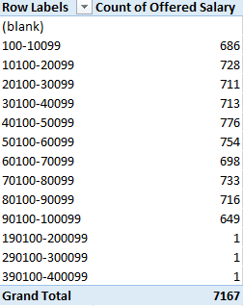
3. Salary Distribution in the company
This pivot table is generated through grouping feature of pivot tables where offered salary is placed under row labels and count of offered salary under values in pivot table.
It is showing the salary distribution within the company.
Insight Found:
After analysis, it has been found that the salaries between 40100 to 50099 is offered to maximum number of candidates.

Slide 8
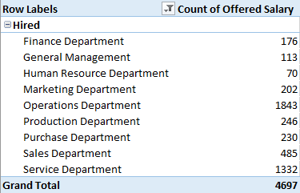
4. Proportion of people working in different departments
Total 4697 number of people were hired by the company. The below table shows the count of people hired for each department by the company.

Slide 9
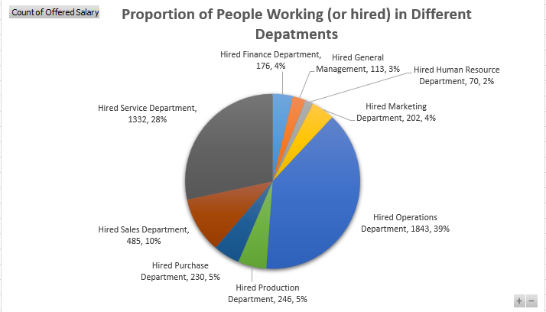
Insight found: After analysis, it has been found that 39% of people are hired for operations department and only 2% of people are hired for HR department. maximum number of hirings are done for operations department and minimum for HR department.
This is the pie chart showing the proportion of the people working in different departments along with their percentage share.

Slide 10
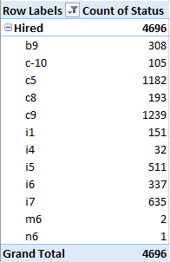
5. Different position tiers within the company
This table is showing the count of hirings as per post

Slide 11
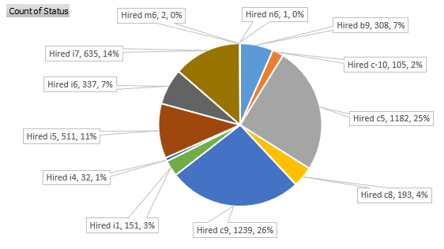
This is the pie chart showing the distribution of the positions within the company.
Insight Found:
After analysis, it has been found that the maximum number of hirings are done for the c9 position that is 1239 and minimum number of hirings are done for n6 position that is 1.

Slide 12
Result
I have performed statistical analysis and answered the questions asked in the project by using various excel formulas. This project also helped me understand EDA (Exploratory Data Analysis) which is used to identify general patterns in the data.
These patterns include outliers and features of the data that might be unexpected. EDA is an important first step in any data analysis. This project also helped me in leveling up my knowledge on statistical analysis and excel formulas too.

Slide 13
Drive Link
Google Drive Link For the Project

Slide 14
Thank You

